Slide 1
ISI 2017- Marrakesh
Transport statistics in Palestine new technology new technique against UN principals
By: Hani Al Ahmed
Marrakesh, Morroco

Slide 2
Palestine in figures
Indicator | Year | Value
Population mid-year (Million) | 2016 | 4.3
Population density (person/km2) | 2016 | 800
Literacy Rate (15 years and above) | 2015 | 96.7
Licensed Road Vehicles in the West Bank | 2016 | 202,270
Percent of private cars of Tot Licensed Road Vehicles in the West Bank | 2016 | 78%
Number of New Registered Road Vehicles in the West Bank | 2016 | 26,328
Rate of Licensed Motorized Vehicles Per 1000 Capita in the West Bank | 2016 | 74.8

Slide 3
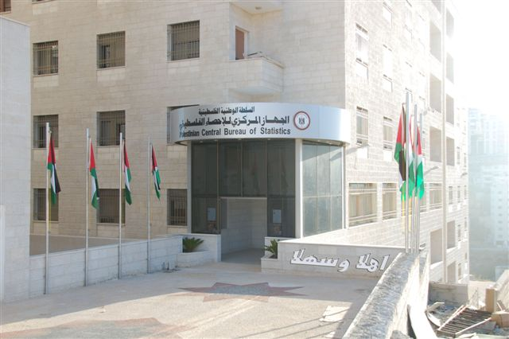
Palestinian Central Bureau of Statistics
PCBS established in 1993
First census 1997 and now prepare to the third census using new technology 2017
300 permanent employees in addition to temporary ones
ISO9001 2008, Palestinine international awawrd for excellent and creativity 2007 and many other awards
EFQM
GSPBM

Slide 4

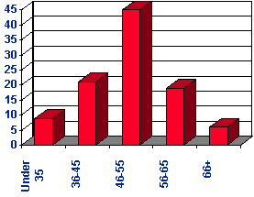


Data
Big Data
Simple table and reports
Metadata
Paradata
…..Data
…. Always new

Slide 5
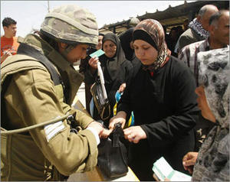
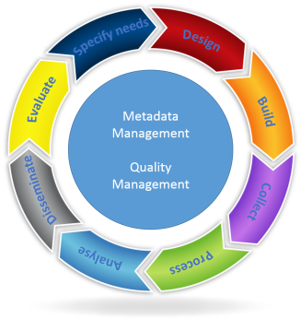


PCBS Challenges and Facts
Occupation is the main challenge
facing our work
Israel dominant
we still use 2G, which start use in 1992, 2001
2G ended
4G and soon 5G
The challenge can we provide statistical figures upon which the planning and decision-making under the various measures which we live? And the answer is always yes

Slide 6

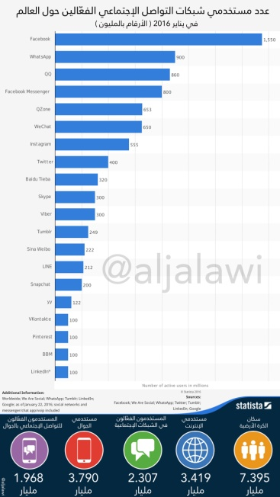
Figures
Global statistics 2016 (LinkedIn)
the percentage of households in Palestine with a Smartphone is 52.1% in 2015
the number of users of social media reached 1,250,000
Population = 7.395 Billion
46% use Internet = 3.419 Billion
Social Media 31% = 2.307 Billion
Chat room
News
Ads
Games
Telecom company
Search
The basis of any planning and construction statistics
provided with the accuracy and quality standardized
It believes that social media has greater than the power of money, and said that the popularity of these sites contributed to the victory ... Donald Trump

Slide 7

Fundamental principles of official statistics
In 1992, the United Nations Economic Commission for Europe (UNECE) adopted the fundamental principles of official statistics in the UNECE region
The United Nations Statistical Commission adopted these principles in 1994 at the global level. The Economic and Social Council (ECOSOC) endorsed the Fundamental Principles of Official Statistics in 2013; and in January 2014
Relevance, impartiality and equal access
Professional standards and ethics
Accountability and transparency
Prevention of misuse
Sources of official statistic
Confidentiality
Legislation
National coordination
Use of international standards
International cooperation

Slide 8
Inside establishment: Annual economic survey.
Outside establishment: vehicles : bark survey (now with MOT using tablet)
Transport statistical Survey in PCBS

Slide 9
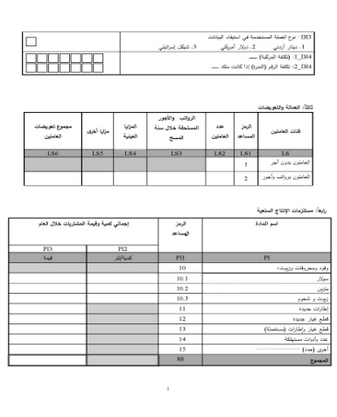
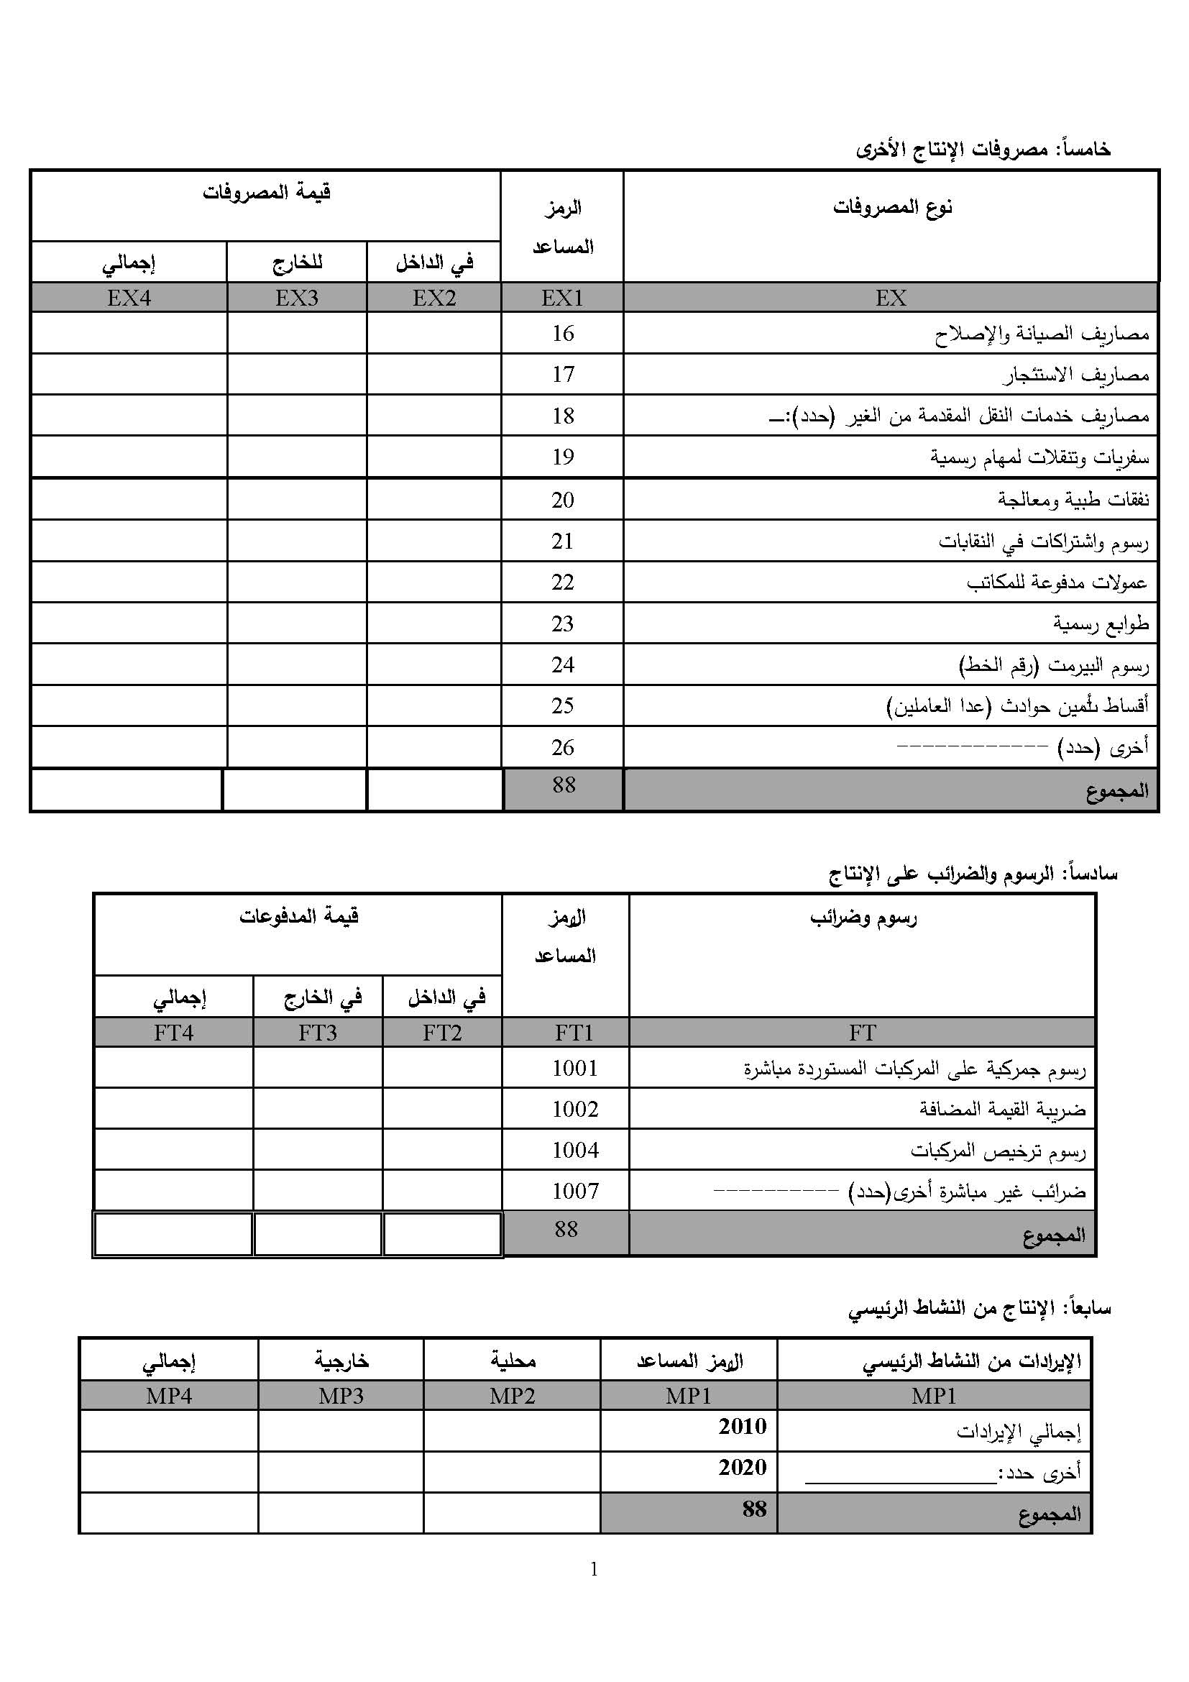
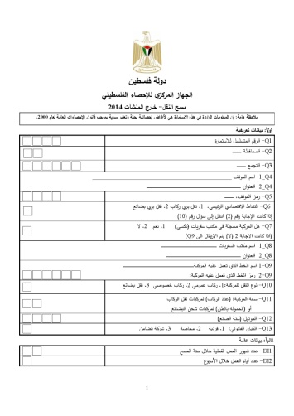
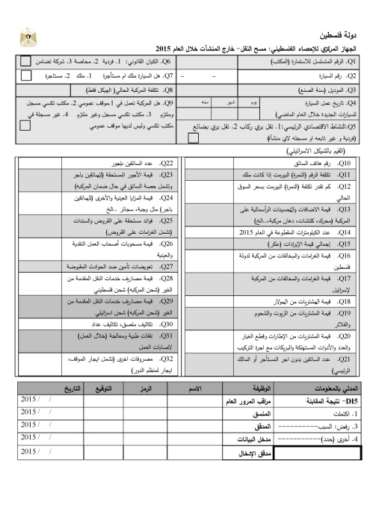
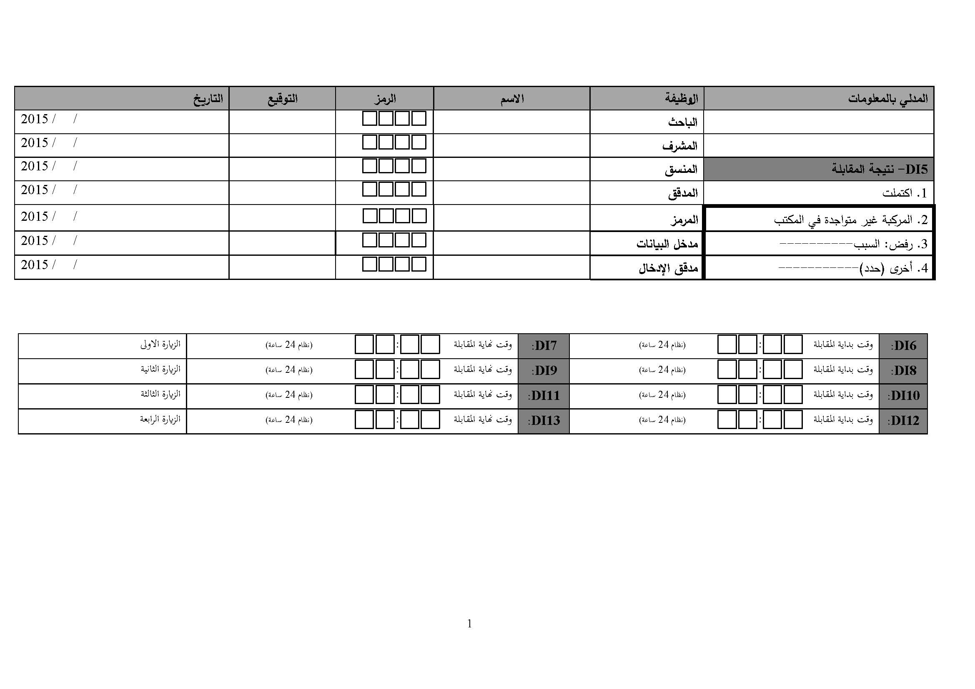
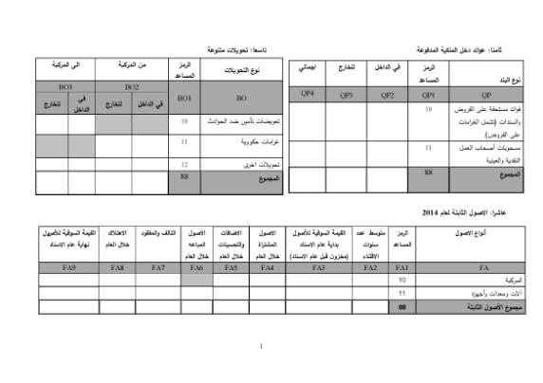
Developing the questionnaire for the Outside establishment transport survey 2015
Desk review for the time series of the micro-data
Reviewing all the Zeros
Eliminate the variables which have an administrative source.
Doing a simple analysis for means and standard deviation to find the variables that have which have C.V less than 0.005.
New Questionnaire
Old Questionnaire
Same Micro data

Slide 10
Developing the questionnaire for the Outside establishment transport survey 2015
Improvement Actions Principle 10: Cost Effectiveness
21 days to finish the field work
13days to finish the field work
Improvement Actions Principle 9: Non-excessive Burden on Respondents
10 minutes to fill the questionnaire
5 minutes to fill the questionnaire

Slide 11

Using new technology (Tablet) 2016 for the outside establishment transport survey

Slide 12
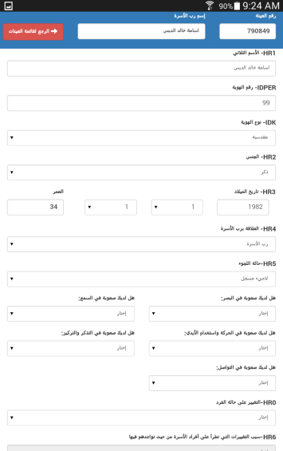
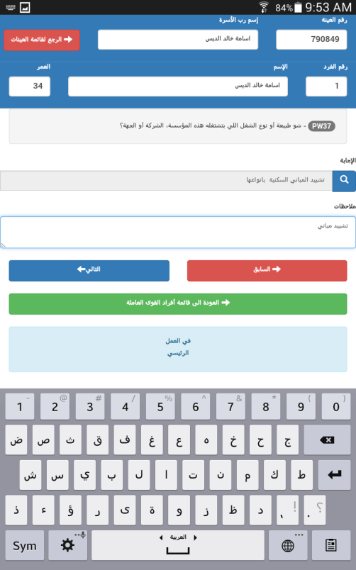
Improvement Actions Principle 10: Cost Effectiveness
6 Stages in 1
4 Stages delete
Printing questioner, quid's, manual
Cost Transfer questioners
Storing cost
Transportation

Slide 13
Improvement Actions Principle 10: Cost Effectiveness
IT Budget before and after using tablet 2016
55% Budget IT

Slide 14
Improvement Actions Principle 10: Cost Effectiveness
Number of employment before and after using tablet 2016

Slide 15
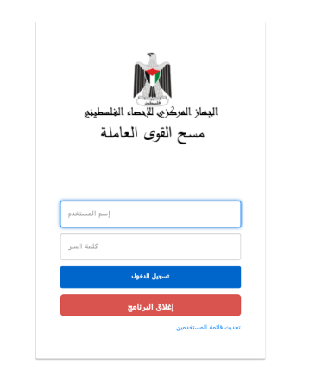
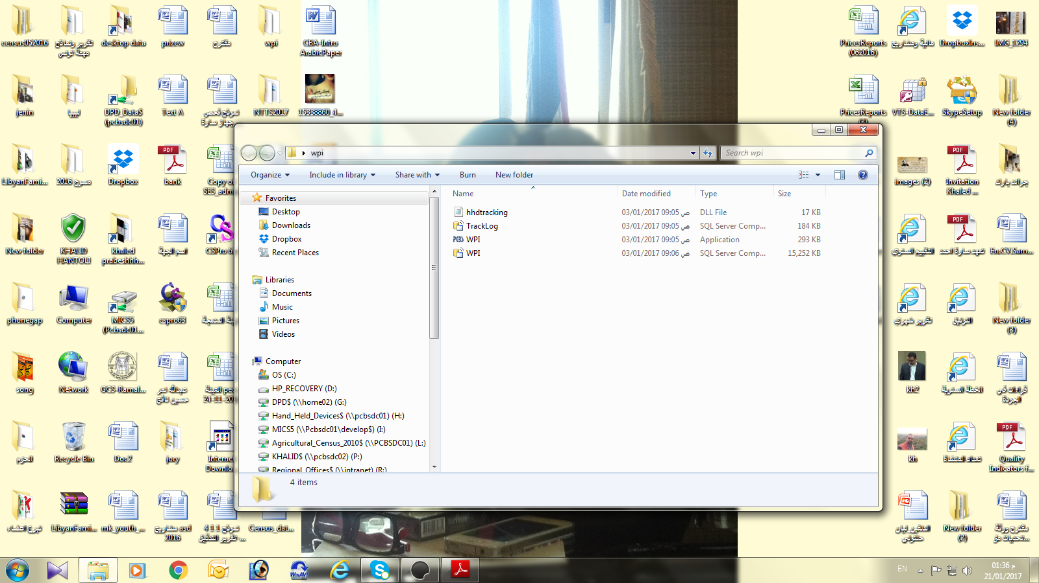

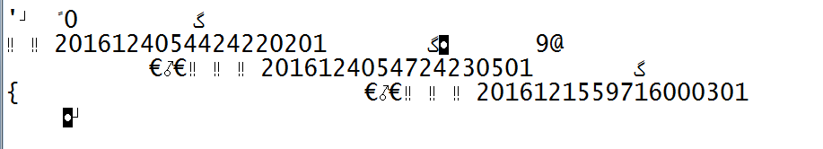
Improvement Actions Principle 5: Statistical Confidentiality
Use a paper questionnaire makes it available for anyone can see (employees, checkpoints soldiers, nosy)
Screen User ID
Data on the device cannot read or interpreted
Encrypted
Who have access to download data from server can read it

Slide 16
Improvement Actions Principle 12: Accuracy and Reliability
Variable | Estimate |  | Standard Error |  | Coefficient of Variation |  | % change
 | 2015 | 2016 | 2015 | 2016 | 2015 | 2016
No. of. Employed Persons | 12157 | 11381 | 65.7 | 48.1 | 0.005 | 0.004 | -20%
Out put | 323195.1 | 285903.5 | 1855.5 | 1145.5 | 0.006 | 0.004 | -33%
Intermediate Consumption | 176018.3 | 160714.2 | 929.5 | 718.8 | 0.005 | 0.004 | -20%
Value Added | 147176.8 | 125189.3 | 1263.4 | 865 | 0.009 | 0.007 | -22%

Slide 17
Lessons learned
New technologies advanced us positively to a new level and exceeded many challenges
New Technology Enhanced the quality

Slide 18


Hani Al Ahmed
hani@pcbs.gov.ps

