Slide 1
GUIDELINE
How to use the Poverty Atlas 2017 http://www.pcbs.gov.ps/site/lang__en/1220/default.aspx?lang=en
Jointly prepared by PCBS and the World Bank team

Slide 2
OUTLINE
PPT section | Action button (ctrl+click)
1. Basic functionality
2. One indicator dashboard:
2.1 One indicator map
2.2 One indicator bar
3. Two indicators dashboard:
3.1 Two indicators map
3.2 Two attributes map
3.3 Two indicators scatter

Slide 3
Basic functionality
Interactive features
Download the underlying data

Slide 4
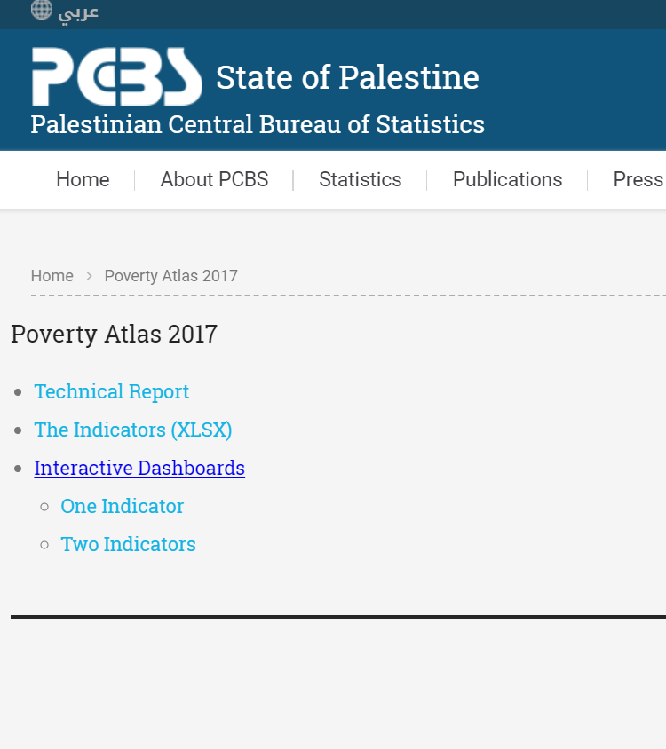
Structure of Poverty Atlas 2017 page
Technical report – contains methodology and all technical details of small area estimation to produce poverty.
The indicators (XLSX) – is excel file which contains 40 indicators derived from Census for 556 localities. It also contains poverty and inequality small area estimates for 151 merged localities.
Interactive dashboards consists of two pages for one indicator and two indicators dashboards.

Slide 5
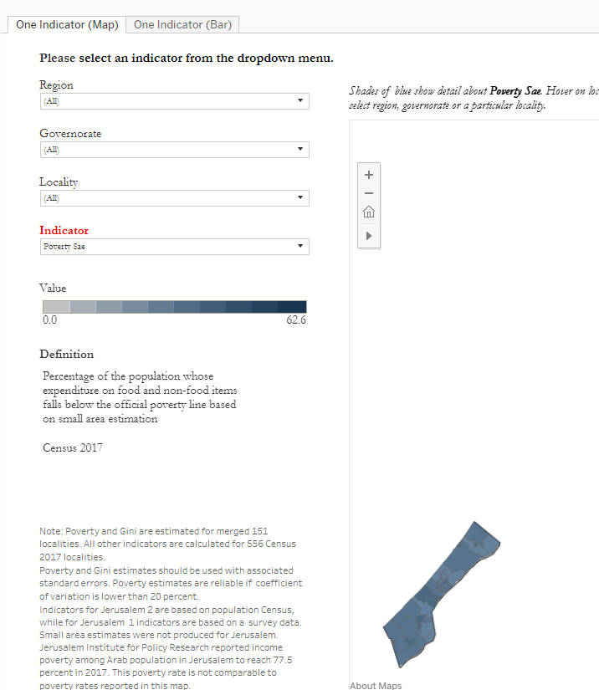
Each dashboard allows you to:
    Select the region
    Select the governorate
    Select the locality
    Select the indicator
    See the definition of selected indicator and its value

Slide 6
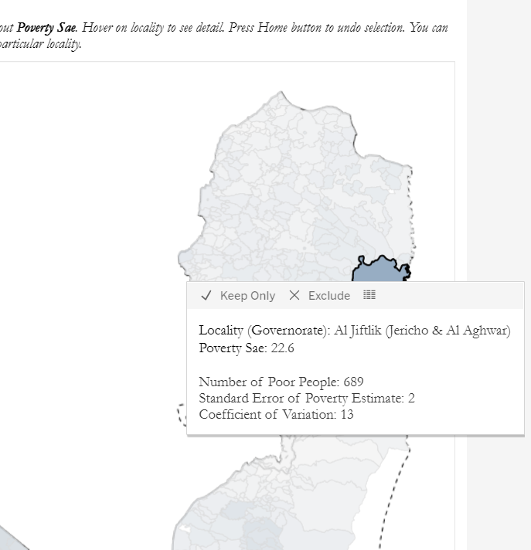
Point mouse to any point on the map and see
highlighted locality
the name of highlighted locality
value of indicator for this locality
When poverty sae is selected as indicator, user can also see
number of poor in the locality
standard error
coefficient of variation
  Poverty estimate with coefficient of variation higher than 20 percent is not accurate from statistical point of view

Slide 7
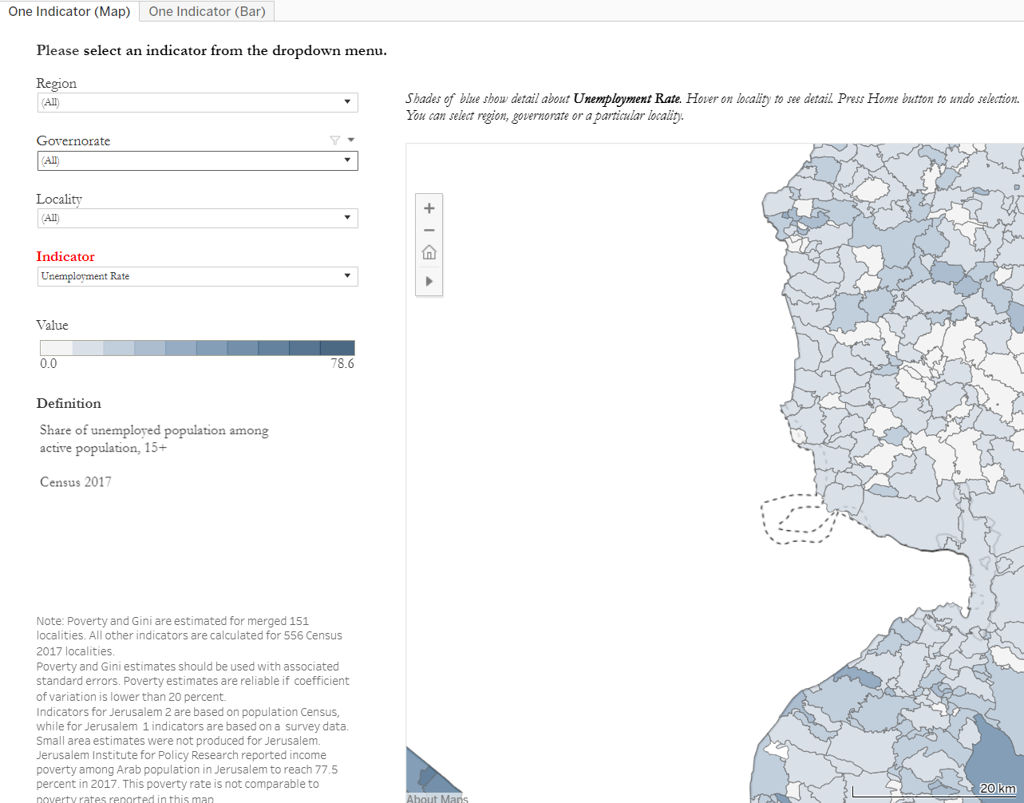
Home button
Home button zooms back the original map

Slide 8
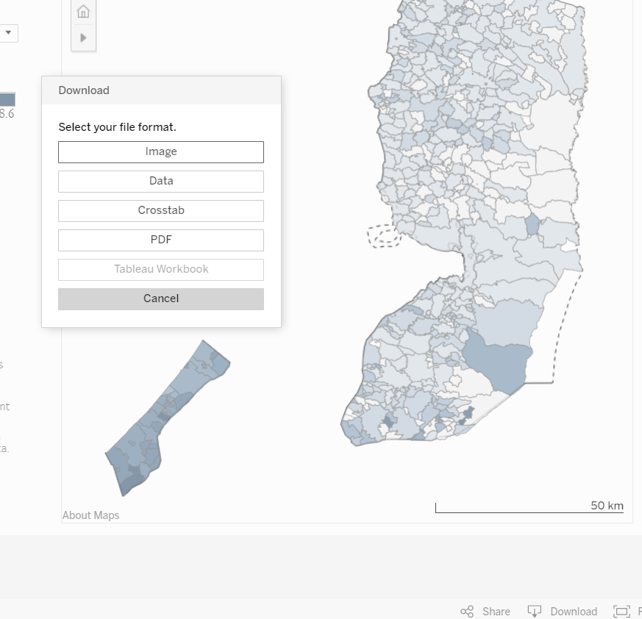
Underlying data from the dashboard can be downloaded
  Use download button at the end of the page
  Select in which format you want the data to be downloaded:
    Data
    Crosstab

Slide 9
One indicator dashboard
One indicator map
One indicator bar

Slide 10
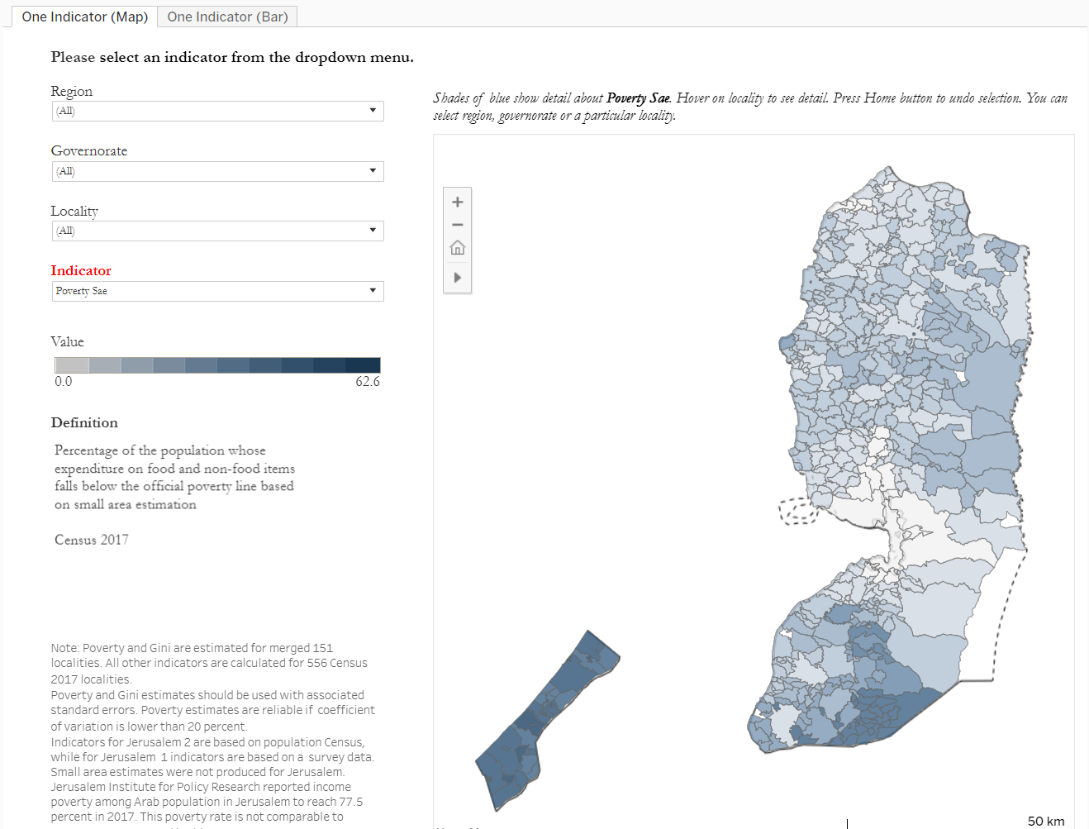
One indicator dashboard has two tabs:
  One indicator map
  One indicator Bar

Slide 11
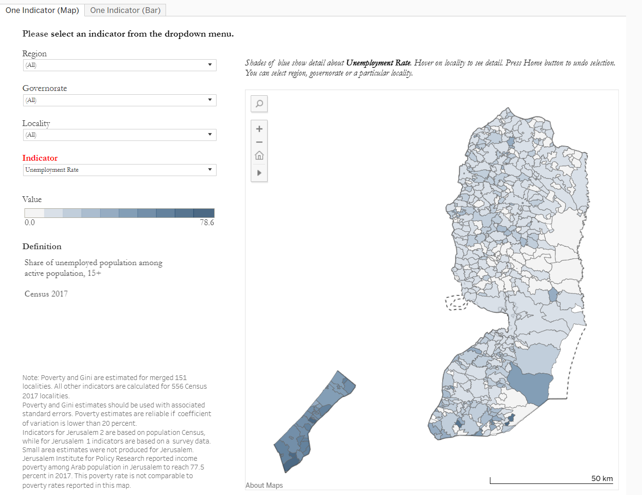
One indicator map

Slide 12
One indicator map shows poverty and Census indicators in the form of map for 556 localities.
Darker color indicates higher value of indicator.
One can see that Gaza localities are all very poor, while in West Bank region there are pockets of high poverty (highlighted with red circles)

Slide 13
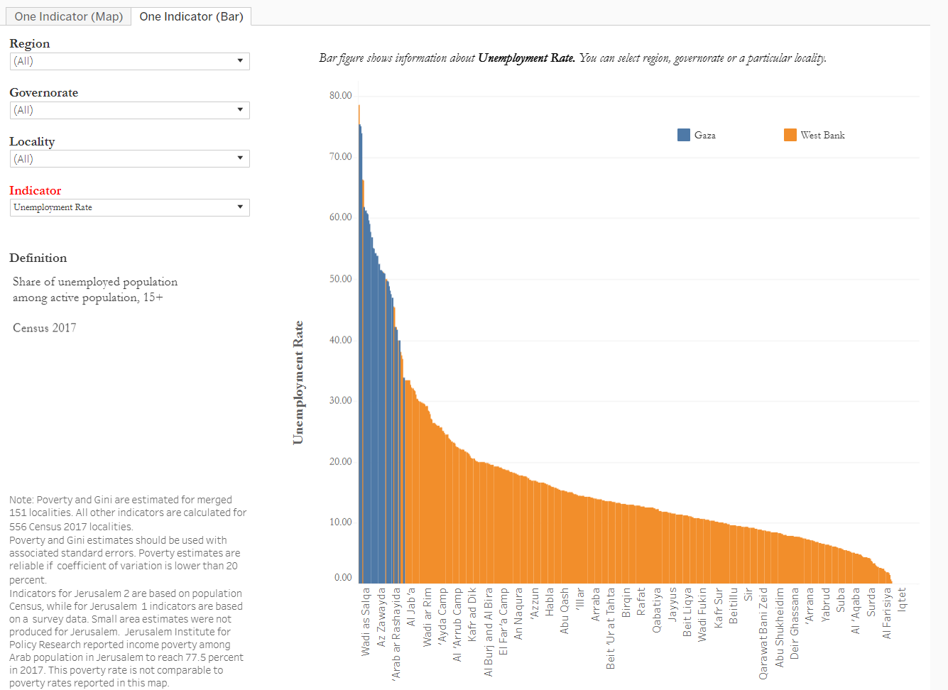
One indicator bar

Slide 14
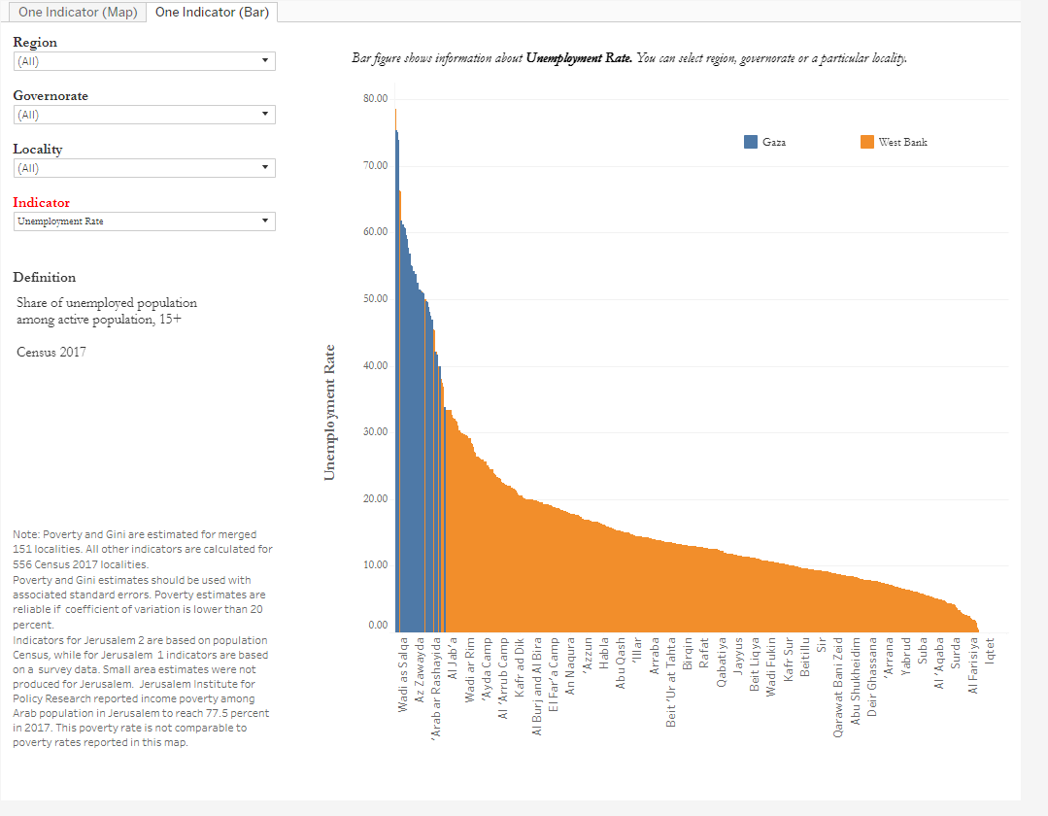
One indicator bar
Has exactly the same functionality as one indicator map
The only difference is that all indicators are presented in the form of bar chart
West Bank and Gaza are highlighted by color

Slide 15
Two indicators dashboard
Two indicators map
Two attributes map
Two indicators scatter

Slide 16
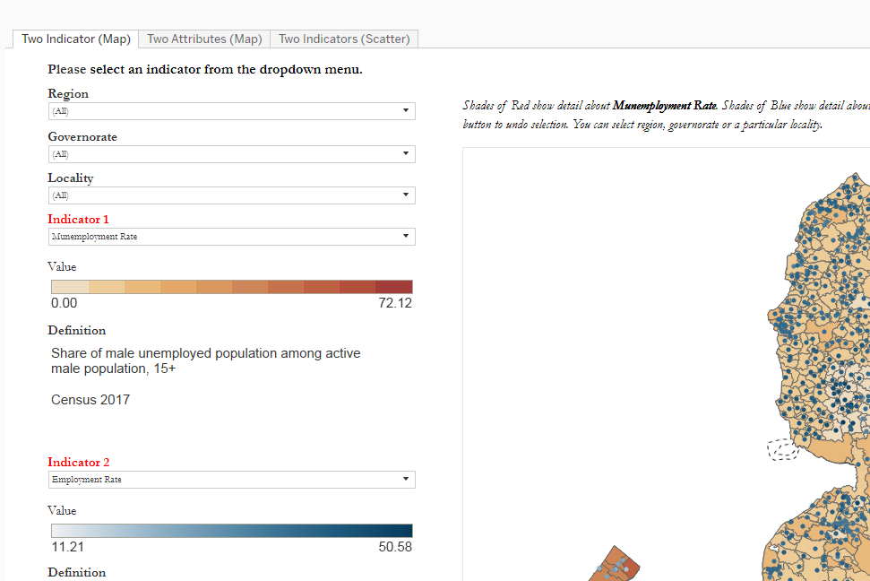
Two indicators dashboard has three tabs:
  Two indicators map
  Two attributes map
  Two indicators scatter
All indicators in two indicators dashboard are calculated for 151 merged localities to make Census indicators measured at the same level as poverty.

Slide 17
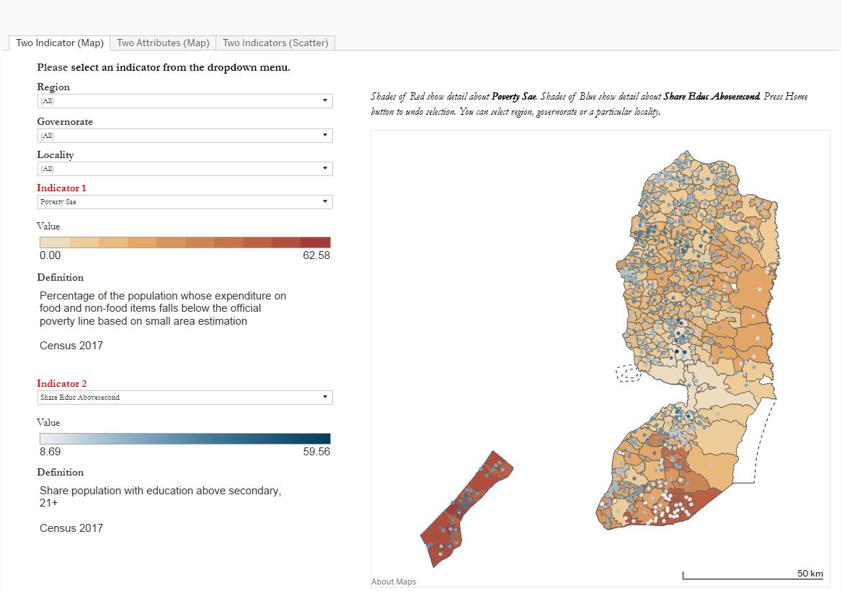
Two indicators map

Slide 18
Two indicators map
Allows to select second indicator and overlay it on the map.
Provides definitions for both indicators and range of values in different colors.
This particular map shows poverty in the form of map and share of adults with education higher than secondary.
Clearly there are areas with high poverty and low education level (red circle) and areas with high poverty and high education level (green circle)

Slide 19
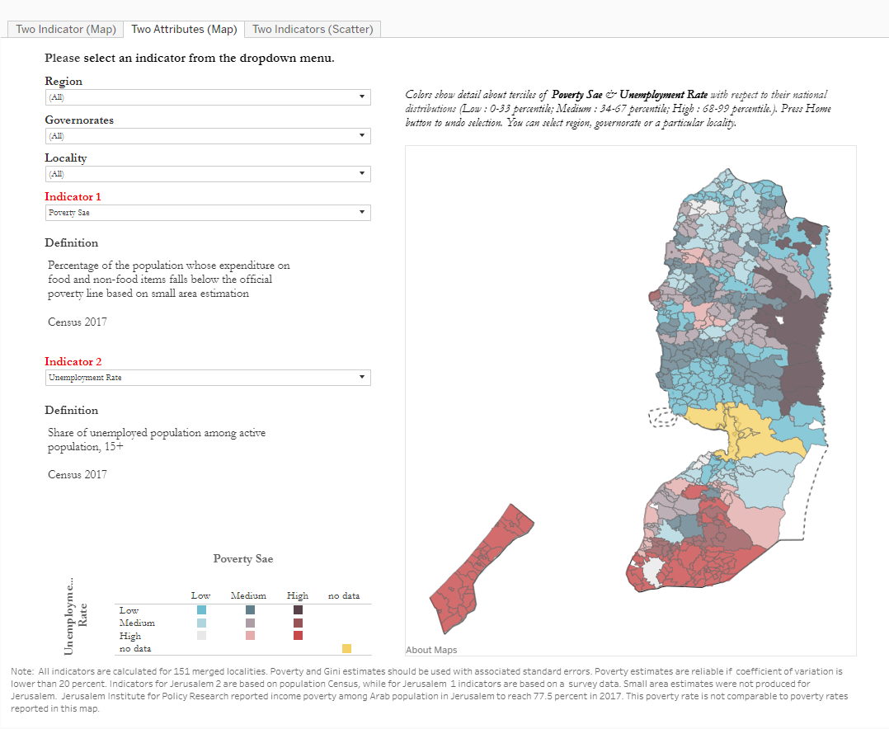
Two attributes map

Slide 20
Two attributes map
Splits each indicator in 3 equal low/medium/high groups and shows how they overlays creating 9 interactions.
This particular figure shows overlay between poverty and unemployment
Two overlays are of a particular interest: i) high poverty versus low unemployment (dark purple color – highlighted by green circle) ii) high poverty and high unemployment (red color – highlighted by red circle )

Slide 21
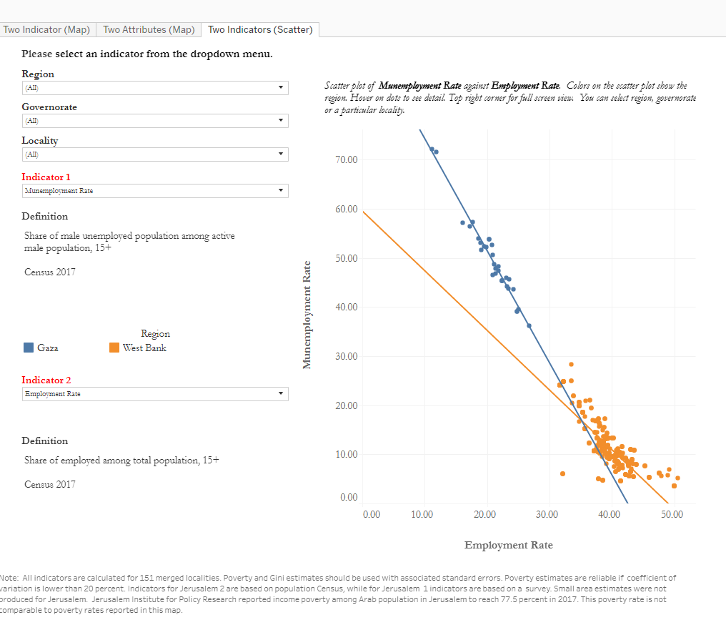
Two indicators scatter

Slide 22
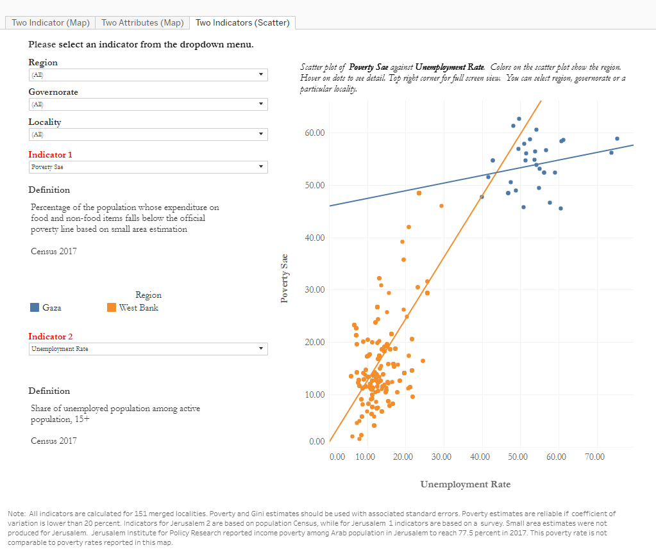
Two indicators scatter
This dashboard overlays two indicators in the form of scatter showing trend lines between them separately for West Bank and Gaza regions.
This visualization allows you to quickly see the relationship between indicators.
On the selected example, we plot poverty versus unemployment.
Clearly, there is positive relationship between these two indicators. However, the relationship is much weaker in Gaza, compared to West Bank.

